Slide 1

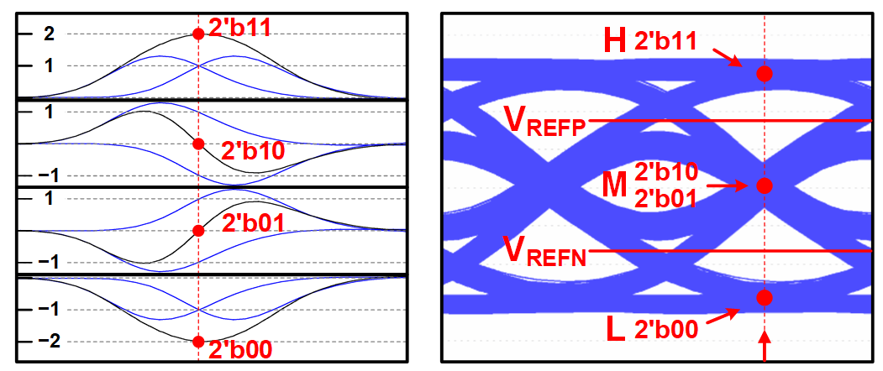
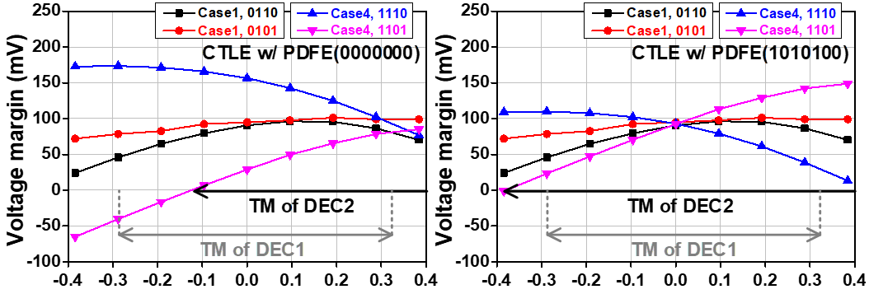

2024 IDEC CDC – SS28 – 2301
A 24 Gb/s Receiver Using Duobinary Sampling for Sub-Baud-Rate CDR
Seungwoo Park, Taehwan Kim and Chulwoo Kim
Korea University, Seoul, Korea
Receiver Architecture
Proposed Duobinary Sampling
Decoding method of H and L by DEC1 (comparators).
Decoding method of M by DEC2 (integrators + comparators).
→ Finally, M is decoded as 01 or 10
Measurement Results
Simulation results w/ and w/o PDFE in 18.4 dB loss
PDFE is used to increase the timing margin (TM) of DEC2
(a) Chip microphotograph and area breakdown. (b) Channel insertion loss
(c) power breakdown, and (d) bathtub curves.
Acknowledgement : The chip fabrication and Electronic Design Automation (EDA) tool were supported by the IC Design Education Center (IDEC), Daejeon, South Korea.

